Slide 1

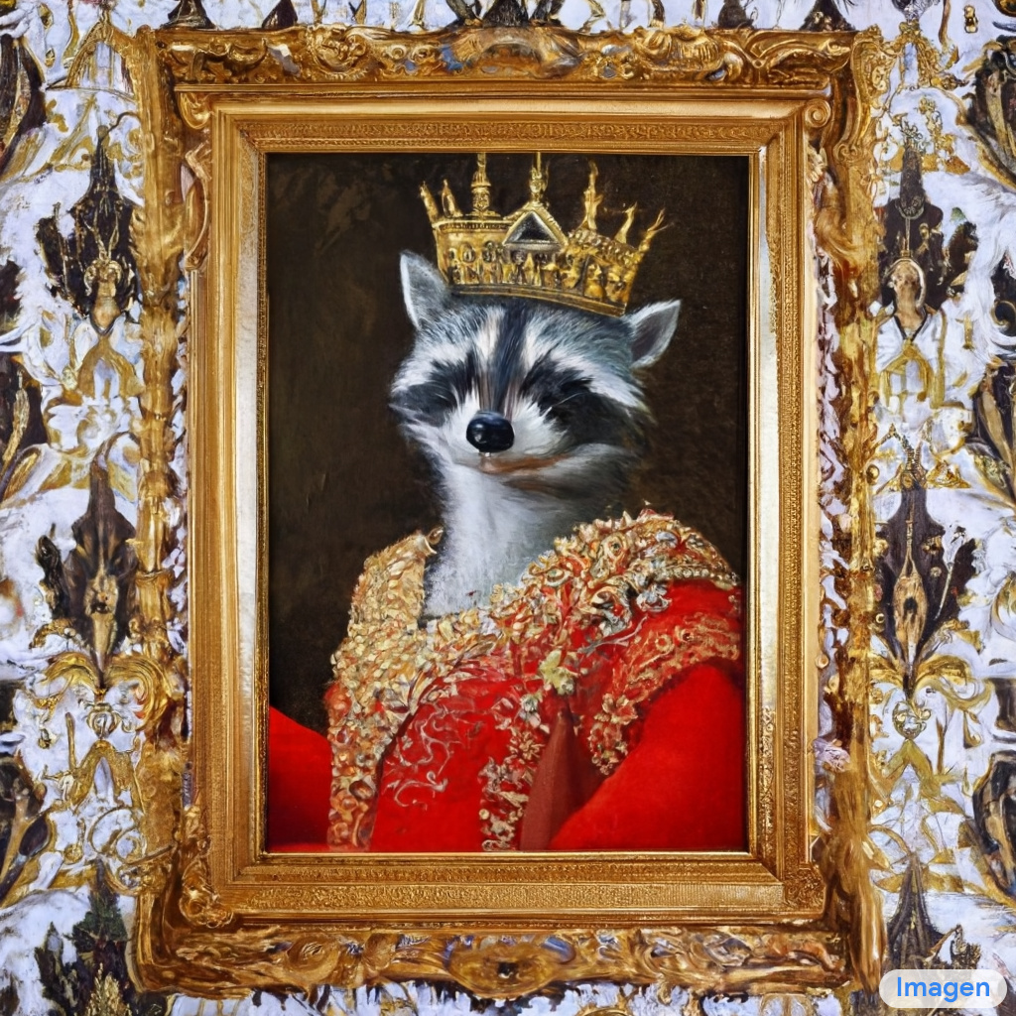

Story of Diffusion Models
By: Iman Khani Jazani
https://github.com/IKJ1992

Slide 2
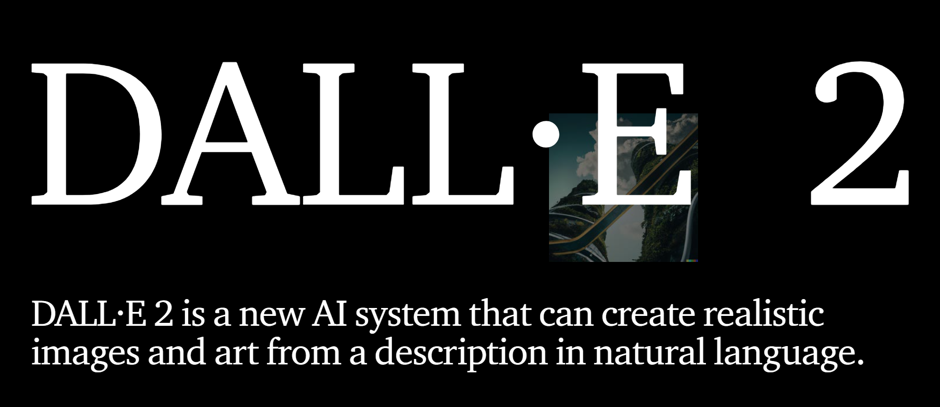
Some examples
https://openai.com/dall-e-2/

Slide 3
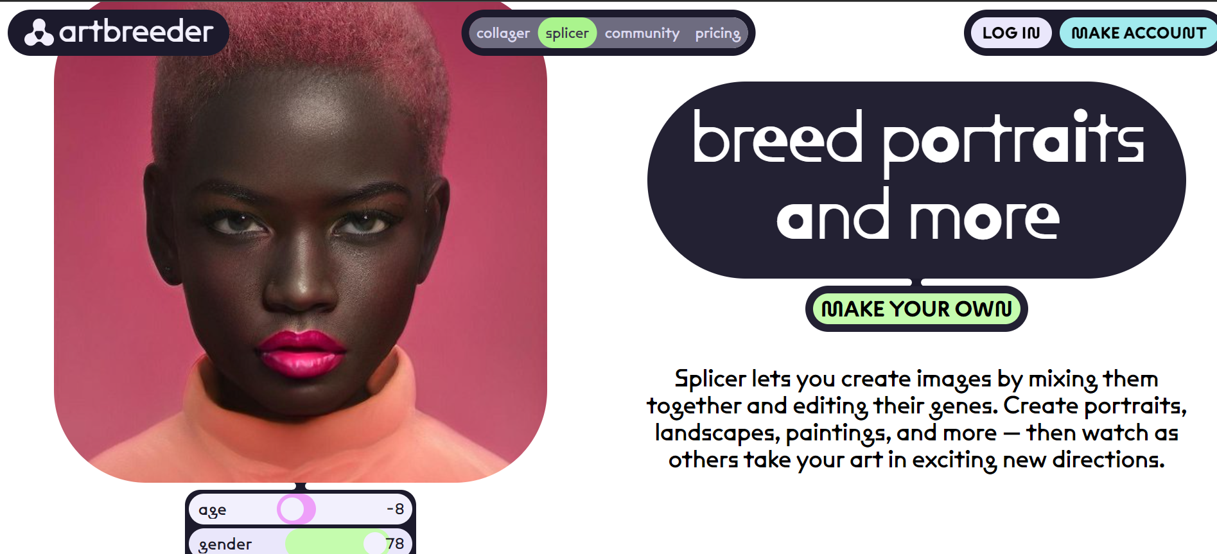
Some examples
https://www.artbreeder.com/

Slide 4
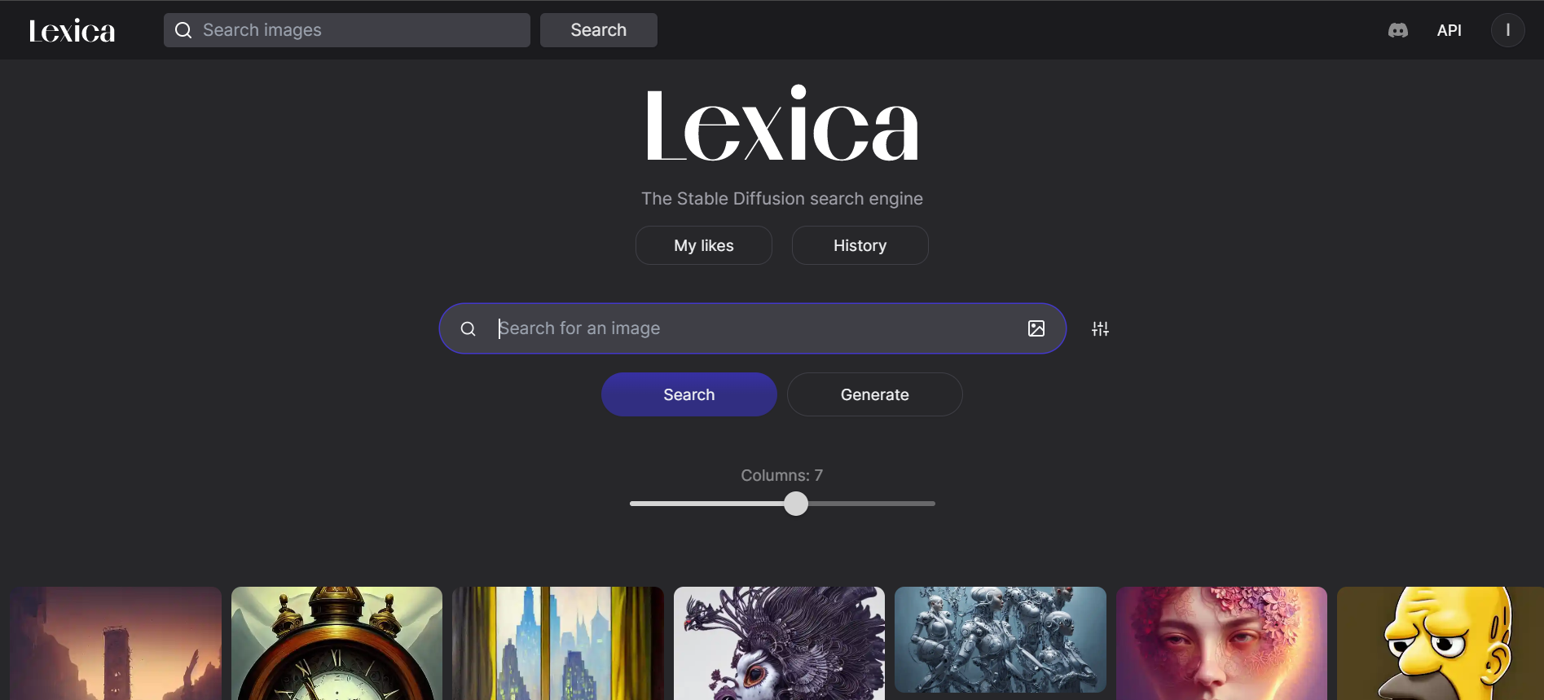
Some examples
https://lexica.art/

Slide 5
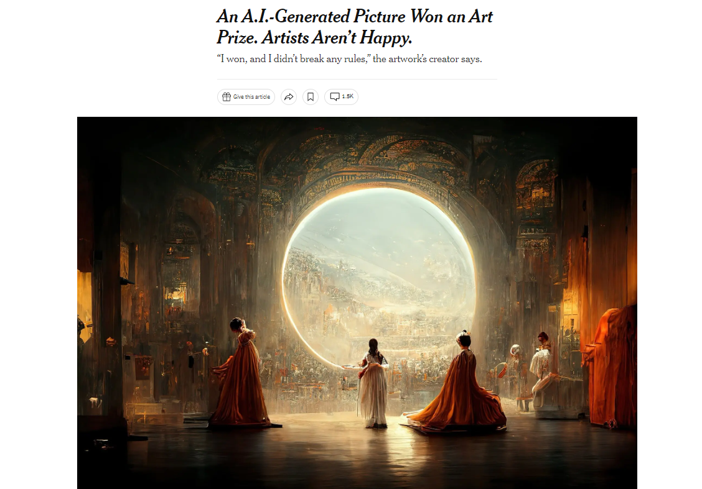
Some examples
https://www.nytimes.com/2022/09/02/technology/ai-artificial-intelligence-artists.html

Slide 6
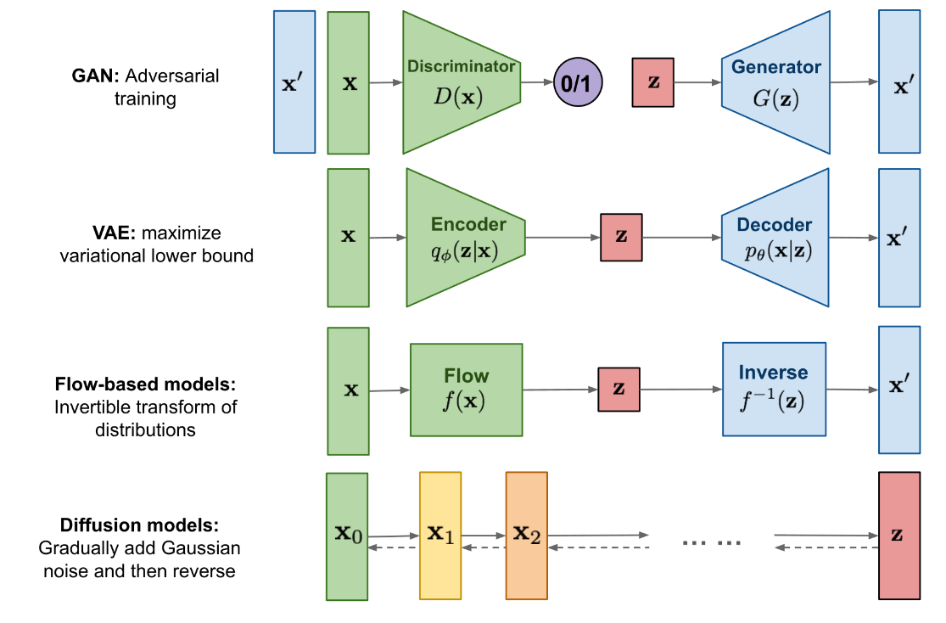
Big picture
https://lilianweng.github.io/posts/2021-07-11-diffusion-models/

Slide 7
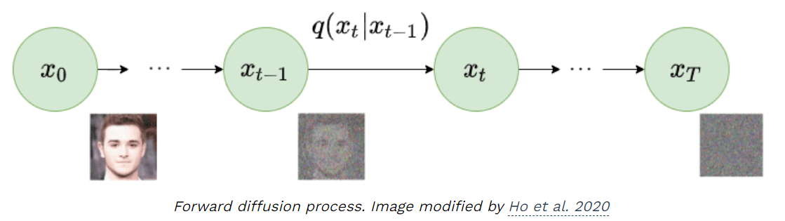
What are diffusion models?
Diffusion models are fundamentally different from all the previous generative methods. Intuitively, they aim to decompose the image generation process (sampling) in many small “denoising” steps.
https://theaisummer.com/diffusion-models/

Slide 8
Different types
Denoising Diffusion Probabilistic Models (DDPM)
stable diffusion
score-based models

Slide 9
Intuition behind
The intuition behind this is that the model can correct itself over these small steps and gradually produce a good sample.
To some extent, this idea of refining the representation has already been used in models like alphafold. But hey, nothing comes at zero-cost.
This iterative process makes them slow at sampling, at least compared to GANs.

Slide 10
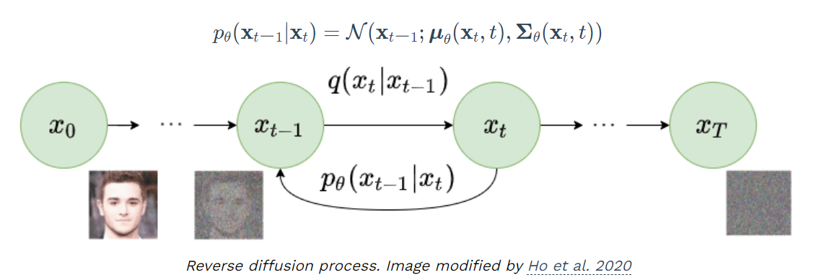
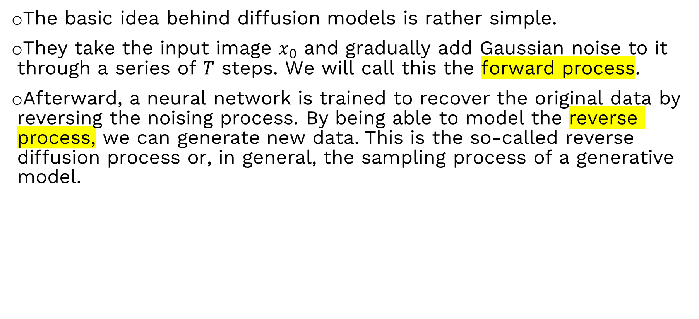
Diffusion process
The basic idea behind diffusion models is rather simple.
They take the input image $x_{0}$​ and gradually add Gaussian noise to it through a series of $T$ steps. We will call this the forward process.
Afterward, a neural network is trained to recover the original data by reversing the noising process. By being able to model the reverse process, we can generate new data. This is the so-called reverse diffusion process or, in general, the sampling process of a generative model.

Slide 11
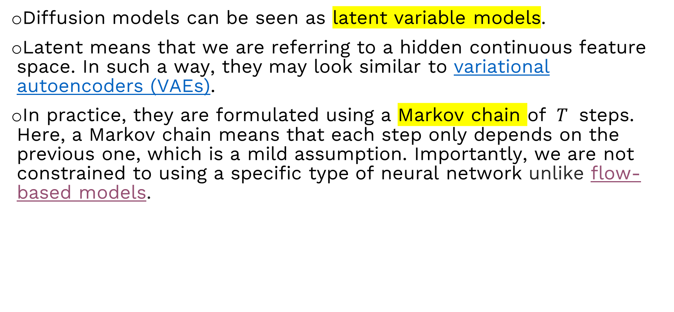
Forward Diffusion
Diffusion models can be seen as latent variable models.
Latent means that we are referring to a hidden continuous feature space. In such a way, they may look similar to variational autoencoders (VAEs).
In practice, they are formulated using a Markov chain of $T$ steps. Here, a Markov chain means that each step only depends on the previous one, which is a mild assumption. Importantly, we are not constrained to using a specific type of neural network unlike flow-based models.

Slide 12
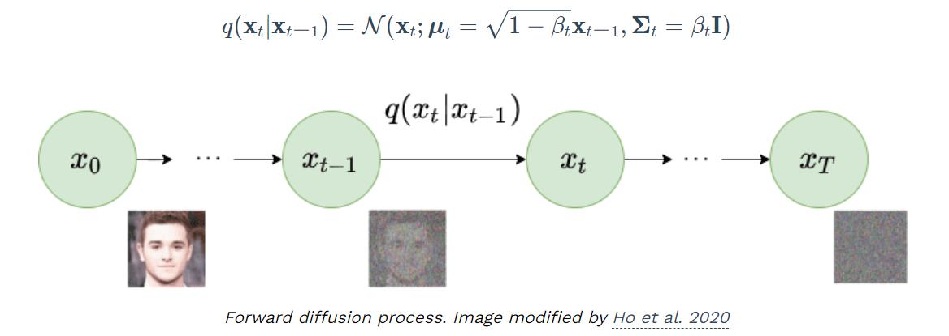
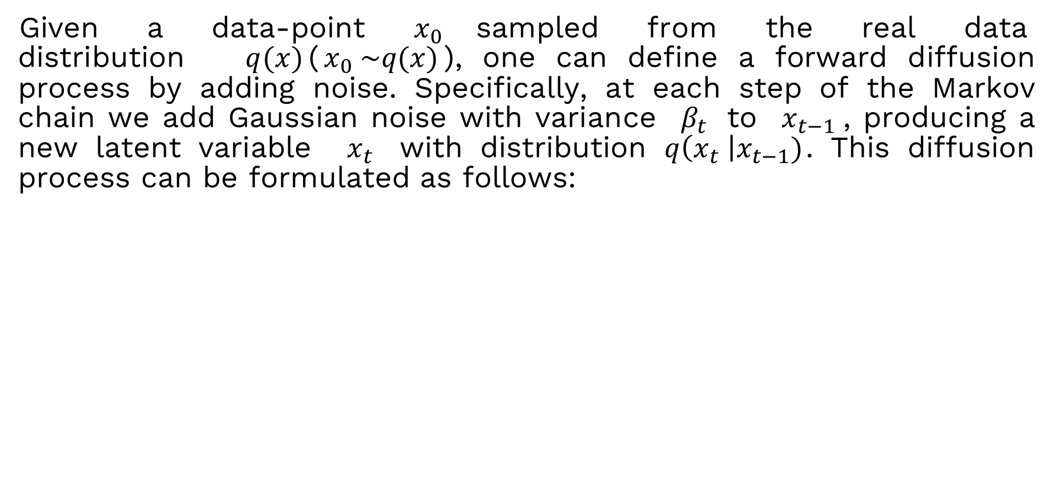
Forward Diffusion
Given a data-point $x_{0}$sampled from the real data distribution $q(x)$($x_{0} \sim q(x)$), one can define a forward diffusion process by adding noise. Specifically, at each step of the Markov chain we add Gaussian noise with variance $β_{t}$ to $x_{t−1}$​, producing a new latent variable $x_{t}$​ with distribution $q\left(x_{t} \right|x_{t−1})$. This diffusion process can be formulated as follows:

Slide 13
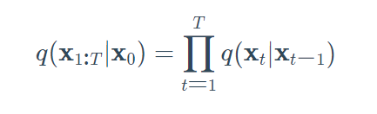
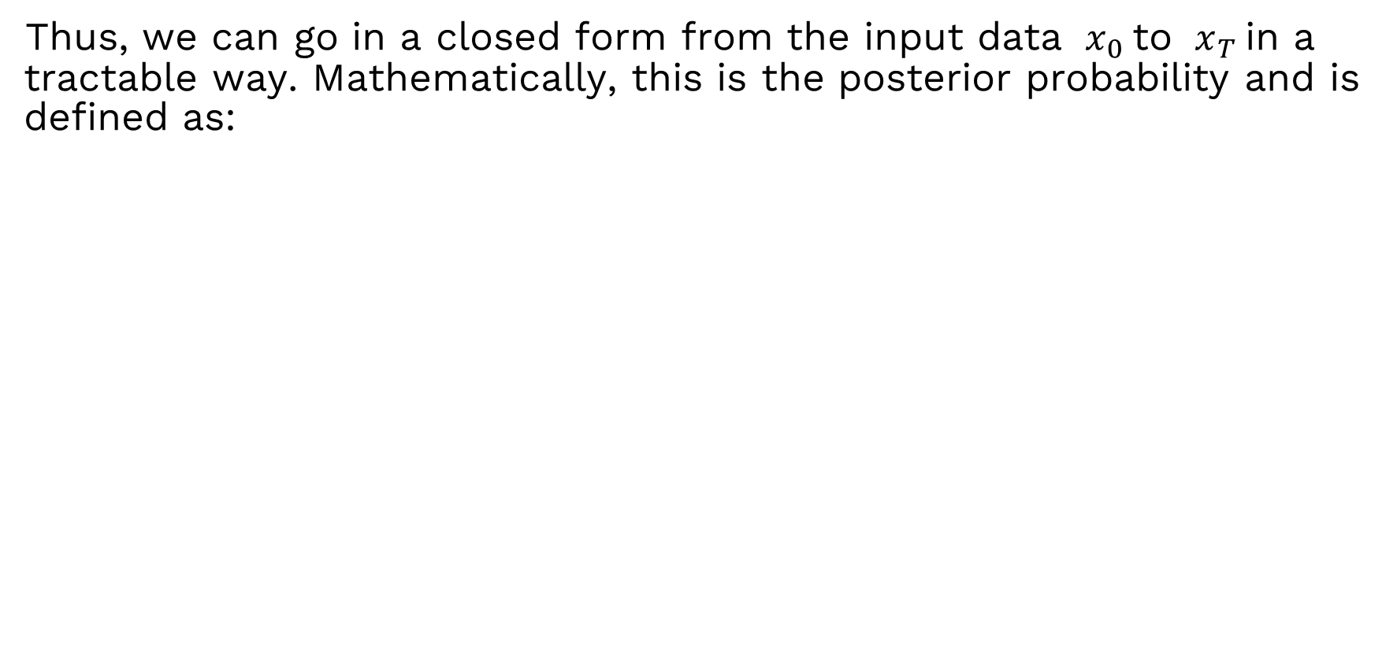
Forward process
Thus, we can go in a closed form from the input data $x_{0}$to $x_{T}$in a tractable way. Mathematically, this is the posterior probability and is defined as:

Slide 14
What!!!
T = 1000 sampling steps

Slide 15
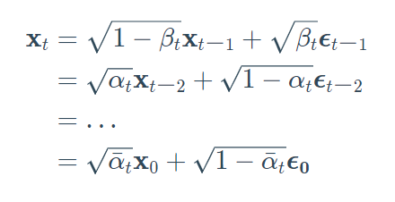
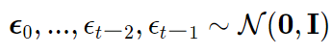
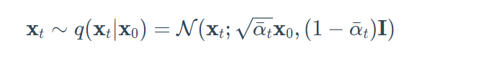
A trick…

Slide 16
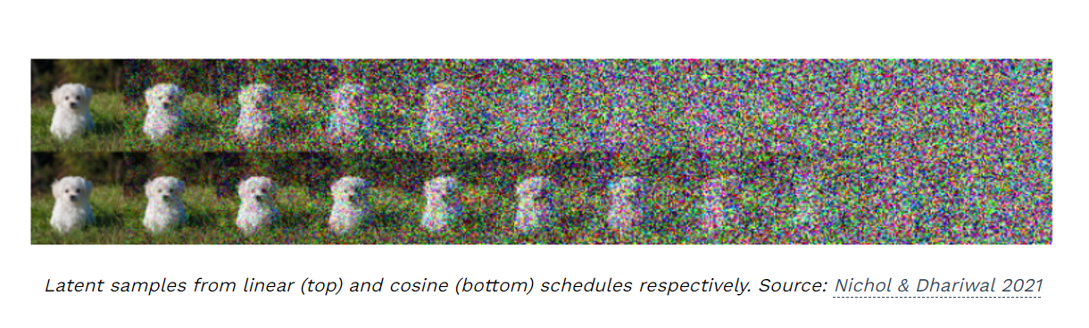
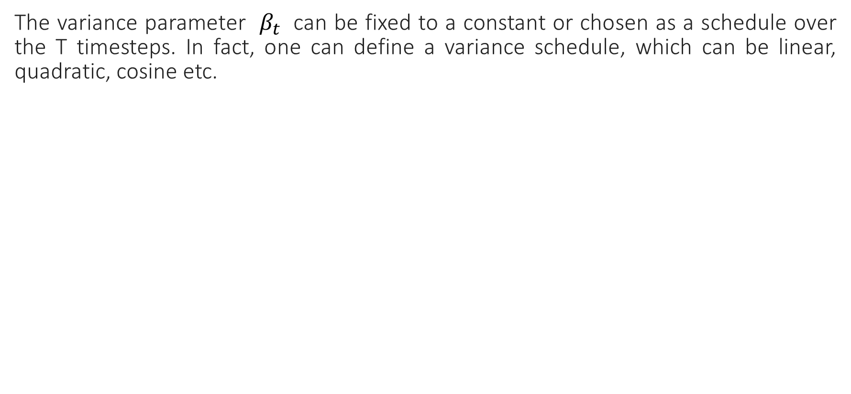
Variance scheduler
The variance parameter $β_{t}$ can be fixed to a constant or chosen as a schedule over the T timesteps. In fact, one can define a variance schedule, which can be linear, quadratic, cosine etc.

Slide 17
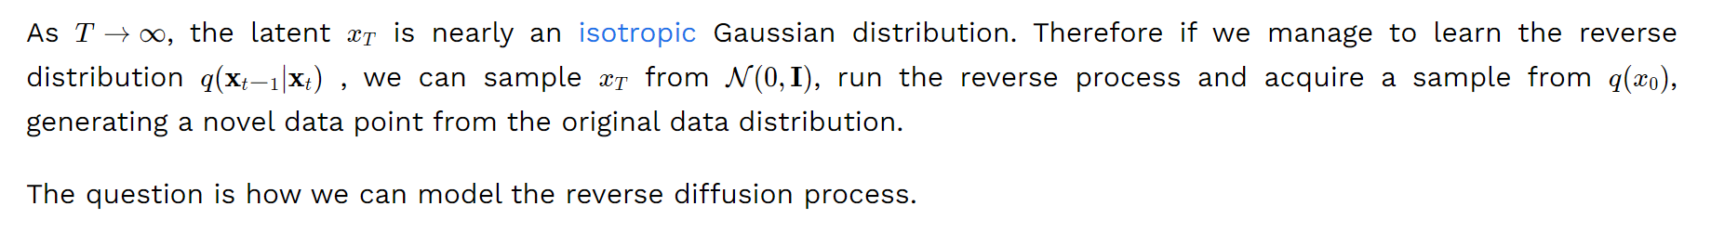
Reverse diffusion

Slide 18
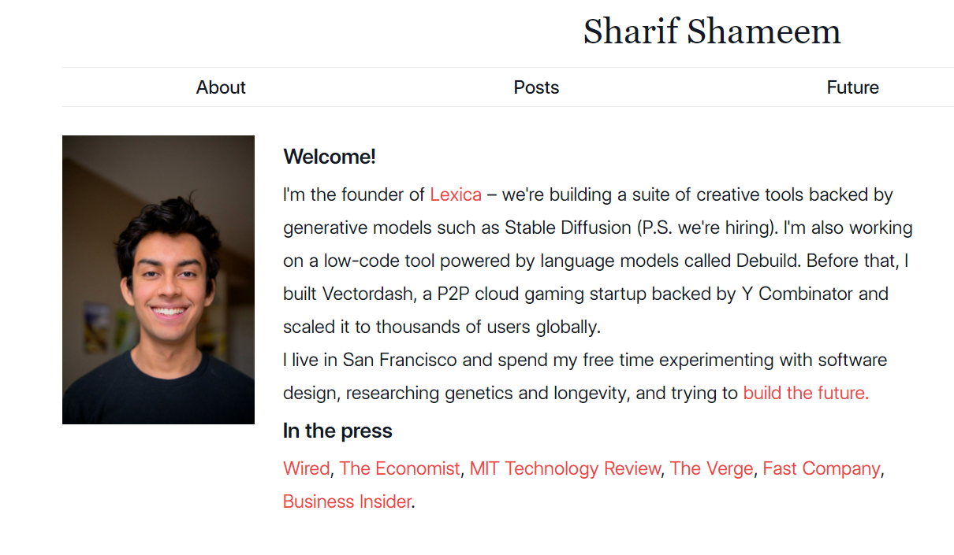
Also, you can do great things…
https://sharif.io/

Slide 19
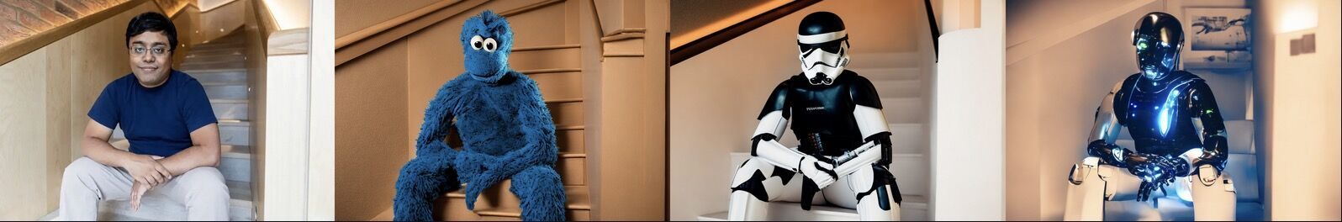

Slide 20
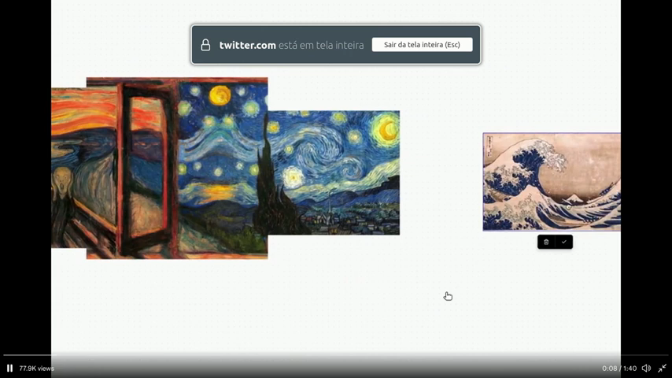

Slide 21
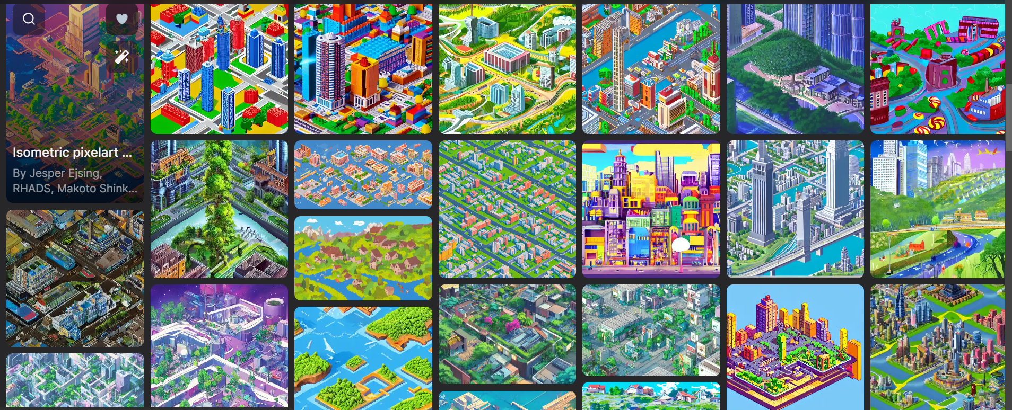
What is Your Idea?
https://github.com/IKJ1992

